Slide 1


Ring Frequently Asked Questions
MTN-025 (HOPE Study)
Community Education Presentation

Slide 2


Why have a vaginal ring for HIV prevention?
Notes:
Offering options for HIV prevention is important because each woman may have different needs.

Slide 3
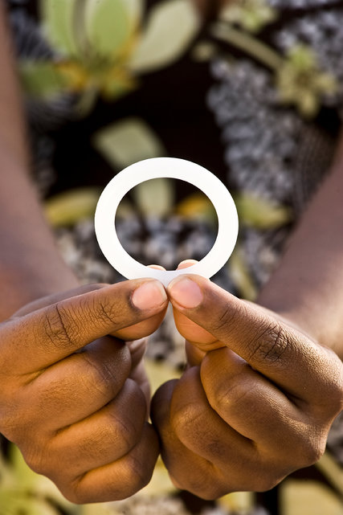

Vaginal rings may offer several benefits:
Longer Acting: Vaginal rings are inserted and left inside the vagina for a month.
Ease of Use: Most women find the ring easy to insert and remove.
Why have a vaginal ring for
HIV prevention?
Notes:
Longer acting rings may help women who find it difficult to remember to use a product daily or at the time of sex.

Slide 4

Safety: Studies have shown the ring is safe to use.
Privacy: Vaginal rings can be inserted and removed in private.
Why have a vaginal ring for
HIV prevention?
Notes:
Some women may appreciate privacy if they do not want others to know they are using an HIV prevention product.

Slide 5
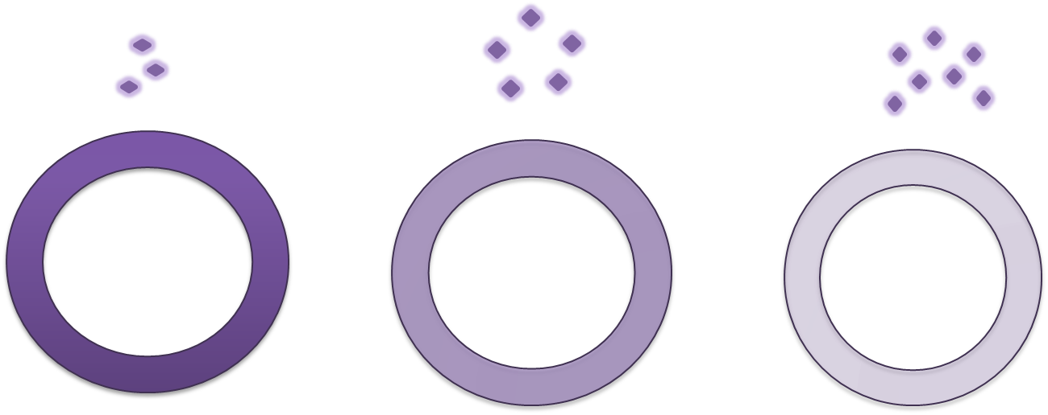

How does the dapivirine vaginal ring work?
When the ring is in the vagina, the medication dapivirine is slowly released.

Slide 6
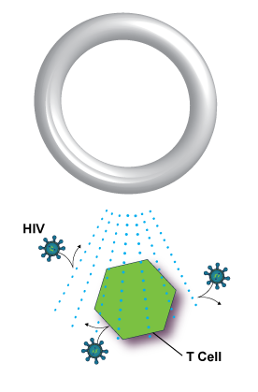
How does the dapivirine vaginal ring work?
Dapivirine works by preventing HIV from making copies of itself, so if a woman is exposed to HIV when the dapivirine ring is in place, the virus is more likely to die before spreading in her body.
Notes:
Studies have shown the dapivirine vaginal ring can reduce a woman’s chance of HIV infection.

Slide 7

How does the dapivirine vaginal ring work?
When used all the time, including during sex and menses, risk of infection is even lower.

Slide 8
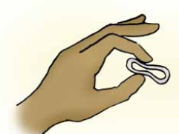
Is the ring difficult to
insert and remove?
Most women find the ring easy to insert and remove.
When the ring is inserted properly, most women do not feel it.
Notes:
No lubrication is typically needed to insert the ring, but water can be used as needed.

Slide 9

Can the ring dissolve or get lost inside the body?
No. The ring will not dissolve.
The ring cannot be pushed too far up or get lost inside the body.
Notes:
Over the course of a month, the medication dapivirine is slowly released but the ring itself does not change.

Slide 10
Will the ring fall out?
This is not common, but may happen.
If women are worried that the ring has slipped out, they can always use their finger to check that it is still inserted or to reposition the ring.
If the ring falls out, it can be rinsed in clean water and may be reinserted.

Slide 11
Are there side effects from ring use?
Studies have shown the dapivirine vaginal ring to be safe to leave inserted for a month at a time.

Slide 12
Are there side effects from ring use?
It does not change the size or shape of the woman’s vagina, cause cervical cancer, or lead to other significant health problems.
The ring does not impact a woman’s menstrual cycle.

Slide 13
Will women or their partners feel the ring during sex?
Some women and their partners may feel the ring in the vagina during sex, but this will not harm either of them.
Women are encouraged to discuss ring use with their partners.

Slide 14

Will women or their partners feel the ring during sex?
Leaving the ring inserted all the time, including during sex, offers the greatest protection against HIV.

Slide 15

What if women get pregnant with the ring inserted? Will it hurt their baby?
Researchers don’t yet know how dapivirine might affect a woman’s baby if she uses the ring while pregnant.
Because of this, women are asked to use contraception while using the ring, and to stop using the ring if they are pregnant.

Slide 16

Is there anything women should avoid while using the ring?
Regardless of ring use, healthy vaginal practices are encouraged by clinic staff.

Slide 17

Is there anything women should avoid while using the ring?
Women should not use douches, soaps, or other detergents to clean inside the vagina.
Women should also not use herbs or other materials to dry or tighten the vagina.
Notes:
These practices are harmful and can increase the chance of vaginal infections.

Slide 18

Is there anything women should avoid while using the ring?
While using the ring, use of diaphragms, menstrual cups, and cervical caps is also discouraged and use of contraceptive vaginal rings is prohibited.

Slide 19
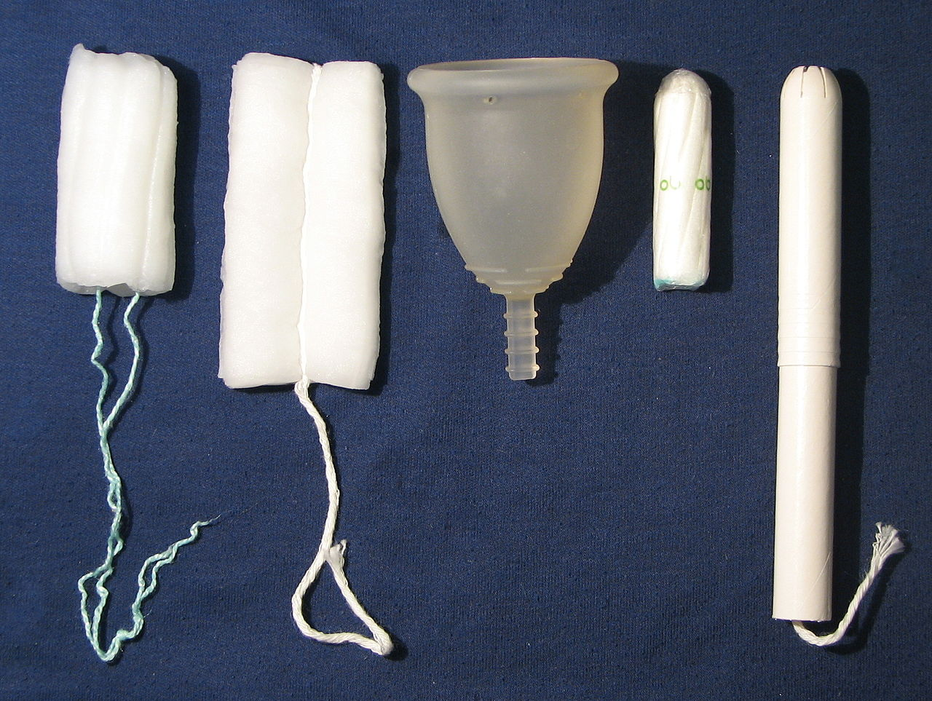
Is there anything women should avoid while using the ring?
Women may use tampons, male and female condoms, spermicides, lubricants, IUCDs (loop), and other vaginal medications or devices prescribed by a doctor.

Slide 20

If you have questions or need more information, please visit the study clinic.

